Slide 1


Risky Business? Deep Dives into DeFi
Data INCITE Undergraduate Researchers | December 14, 2022

Slide 2
Agenda:
Overview of DeFi/AAVE
Structure of Data
Liquidations
User Clustering
Survival Analysis
Data Engine
Survival Analysis Toolkit

Slide 3
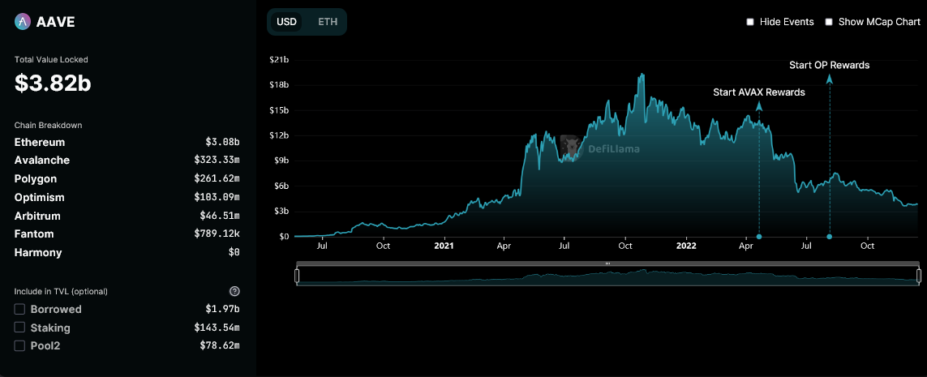
DeFi is Changing Finance:
Motivation:
How is DeFi reshaping/replacing
traditional finance?
Decentralized Finance (DeFi):
Software-driven, cryptocurrency-based alternative to traditional financial
products
AAVE:
Largest DeFi lending protocol (bank)
Our test case

Slide 4
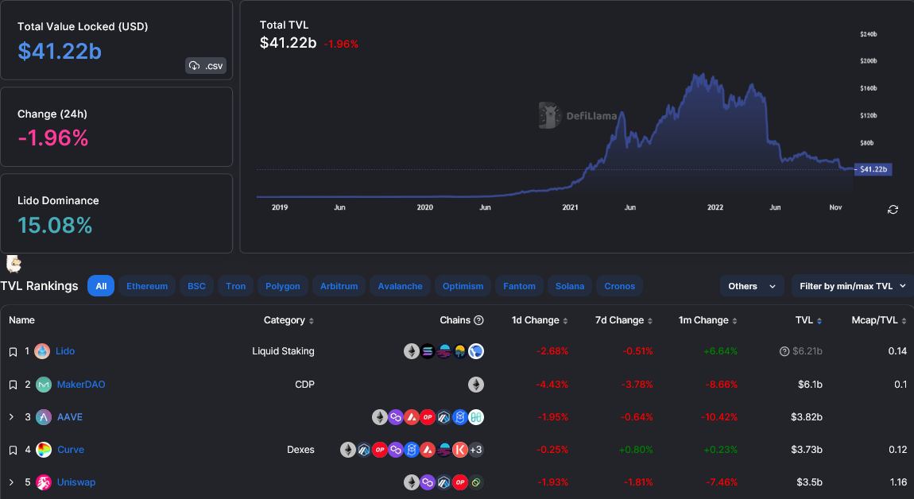
DeFi Overview:
Notes:
https://defillama.com/

Slide 5

What is AAVE?
Largest lending protocol in DeFi
~$3.82 billion worth of crypto assets in the protocol
Users interact with AAVE through transactions:
Deposit
Redeem
Borrow
Repay
Liquidation Call
Collateral Swap
Flash Loan
etc.
Notes:
https://defillama.com/protocol/aave

Slide 6
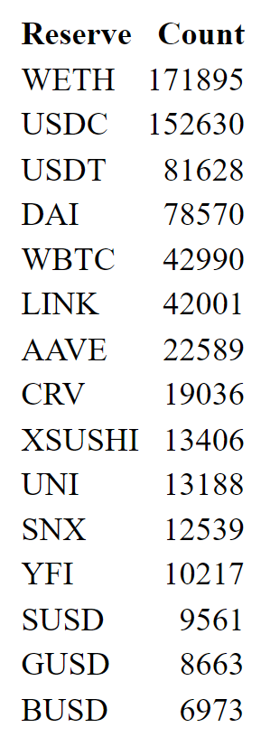
Types of Cryptocurrencies
Cryptocurrencies are the currency of Aave transactions
Cryptocurrency prices are volatile
Most coins (Bitcoin, Ethereum, Doge, etc.) are subject to large fluctuations in price
Stable coins are cryptocurrencies with constant value
Tether (USDT), USD Coin (USDC), DAI
Pegged to the value of USD ($1)

Slide 7




Data Overview:
DeFi Source
Data Feed Providers
Researchers

Slide 8
Data Overview:
Data for time period of November 2020 to October 2022
User transaction data from Aave Mainnet V2
1,475,175 rows and 36 columns
Timestamp
Amount
User
Transaction type
Etc.
Derived datasets (i.e. survival) created from this transaction data
Other markets (V2 and V3) used less frequently
Data source: thegraph.com
Aave-maintained subgraphs for each market

Slide 9
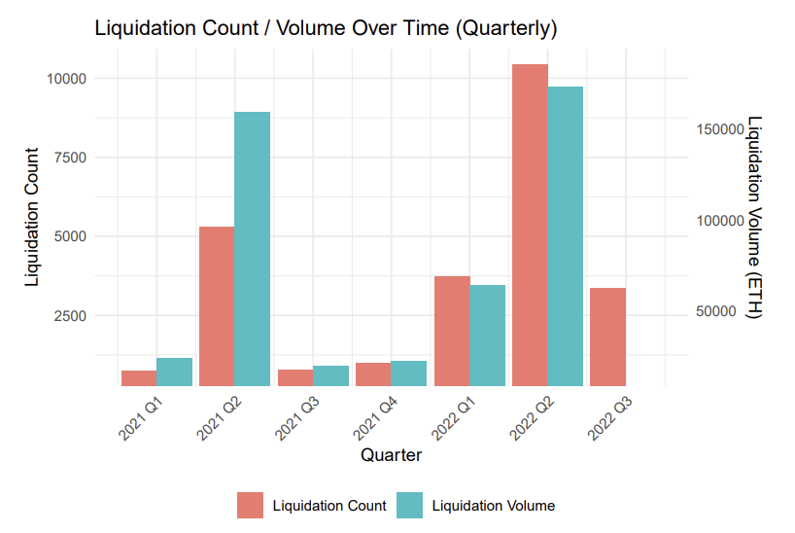
Liquidation Volume and Count
Liquidation volume and count spikes in response to market events
Liquidation count and volume closely follow each other

Slide 10
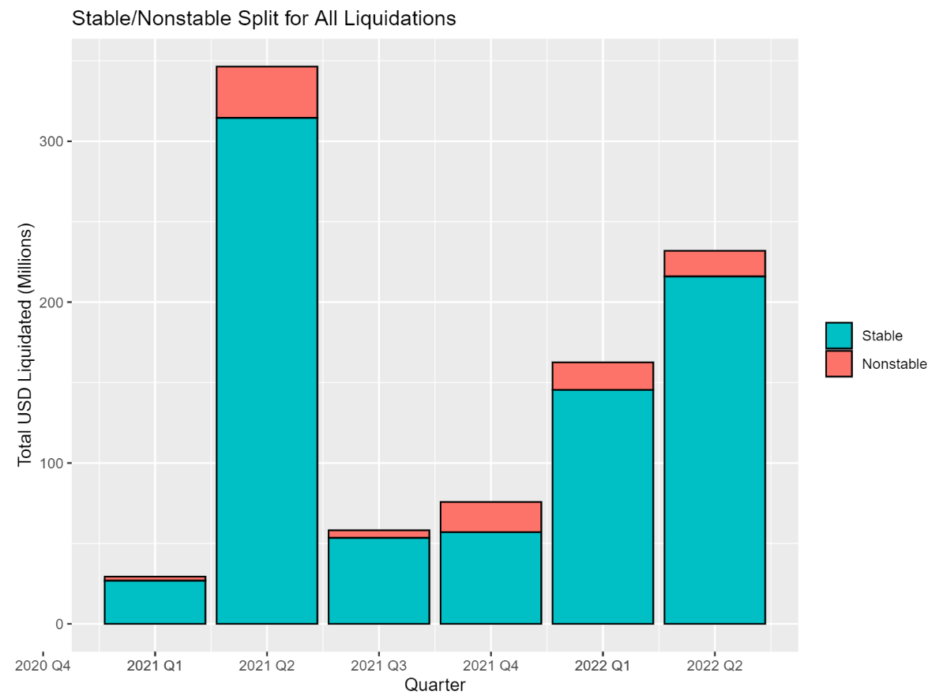
Total Liquidation Volume
The vast majority of liquidations - and borrows - are from stablecoins (USDC, USDT, DAI, etc.)
Larger volume in bearish quarters

Slide 11
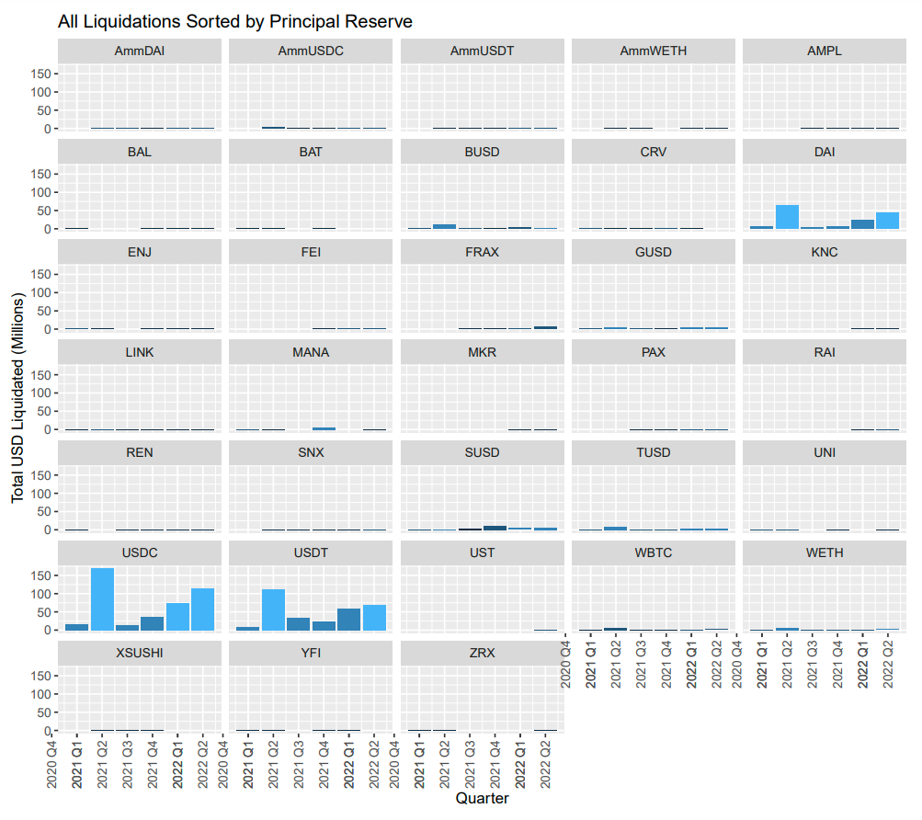
Liquidations by Principal Reserve
Stablecoins are, by far, the most borrowed cryptocurrencies
Borrowing stablecoins reduces the probability of liquidation
Much less likely to significantly depreciate in value

Slide 12
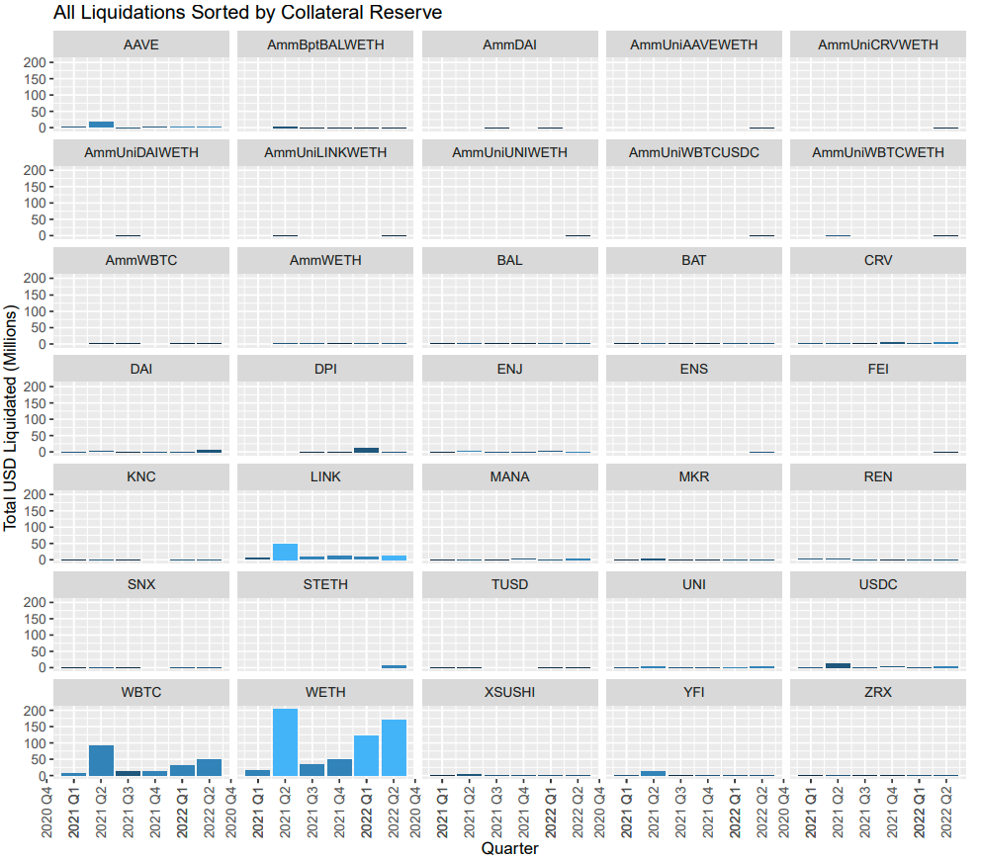
Liquidations by Collateral Reserve
Wrapped Ethereum, Wrapped Bitcoin, and Chainlink account for 84.41% of all liquidated collateral
The average user puts nonstable coins up as collateral and borrows stablecoins

Slide 13
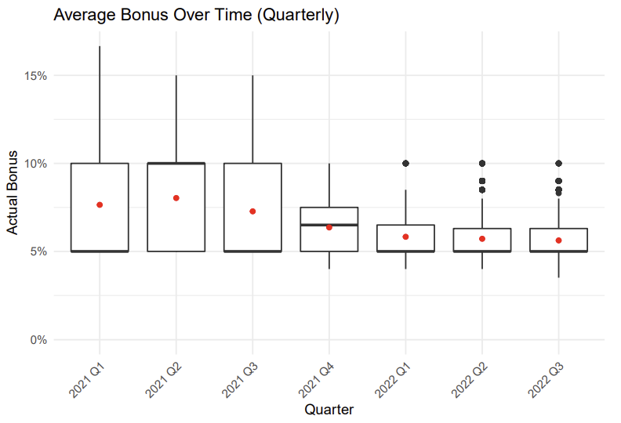
Platform Efficiency - Average Bonus
Average bonus and variance both gradually decreases over time.
Increased efficiency and stability of the protocol
Notes:
Bonus incentivize keepers
in this section, we’ll take a look at the overall trend of the bonus percentage
before that
average bonus: computed using collateral over principal
average of the actual bonus for each collateral
box plot, red dot represents the average bonus
both actual bonus and its variance gradually decreases
what this mean is that
increase in “efficiency” as well as the stability of the protocol
as the decreasing of the bonus percentage suggests that
requires less incentive for the keepers to still do their job
this is a good sign for the health of the protocol

Slide 14
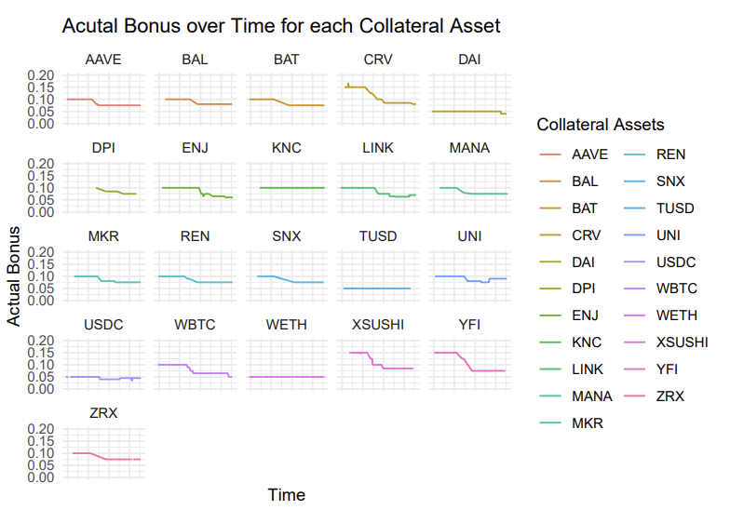
Platform Efficiency - Actual Bonus
Most collateral assets have decreasing actual bonus over time
Stable collateral assets: KNC, TUSD, WETH, DAI
Recent rebound for UNI, USDC, LINK. Encourage participation?
Notes:
Bonus incentivize keepers
average bonus: computed using collateral over principal
set bonus: current fixed percentage bonus set by Aave, will be updated to reflect the current market status
average bonus >= current set bonus
implies since avg bonus is the running average across quarter, and set bonus is the current bonus percentage,
bonus percentage was higher for most assets in previous quarters

Slide 15
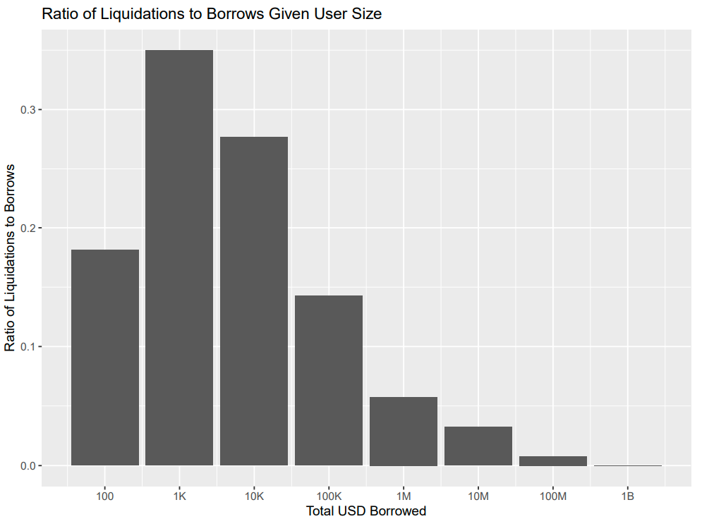
User Analysis
Larger users are significantly less likely to be liquidated
Of 304 borrows from users with total volume over $1B, there were no liquidations
Large users may be better collateralized
Keepers may not have sufficient equity

Slide 16
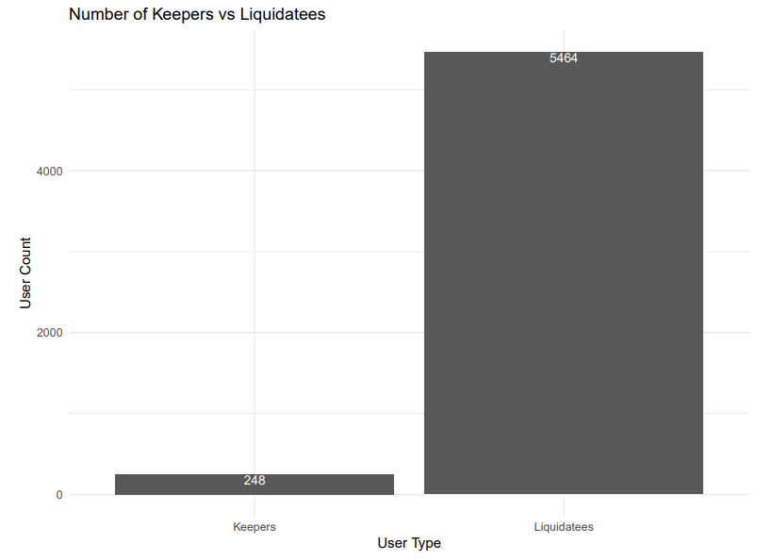
Top Keepers - Keepers v.s. Liquidatees
Liquidatees to keepers ratio is roughly 22.
Centralization of Keepers
Top 5% by count: 70% of all liquidation count
Top 5% by volume: 73% of all liquidation volume
67% of the top 5% keepers overlaps
Extremely centralized
Notes:
248 keepers
roughly 5.5k liquidatees
liquidatees to keepers ratio is around 22
we are only interested in the top keepers
70% of all liquidation call was liquidated by the top 5 percentile of keepers
73% of all liquidation volume was liquidated by the keepers in the top 5 percentile

Slide 17
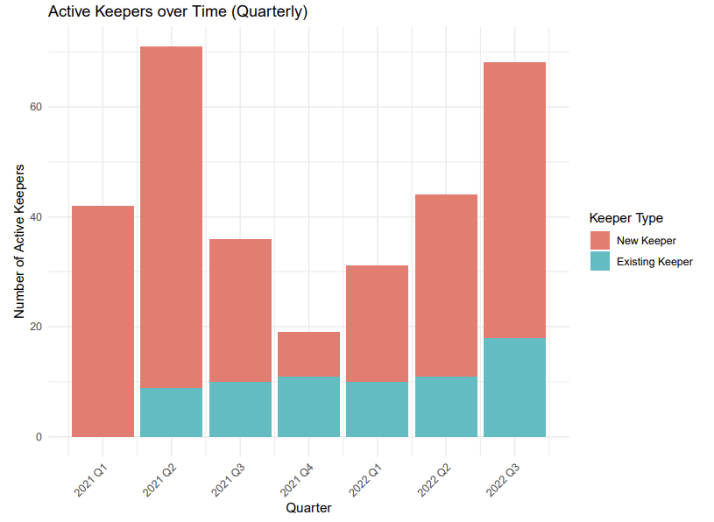
Active Keepers - New v.s. Existing Keepers
Active keepers closely follows liquidation count/volume
Number of existing keepers are relatively stable compared to new keepers
Out of all 248 keepers, less than 10% are long-lived (existing keepers)

Slide 18
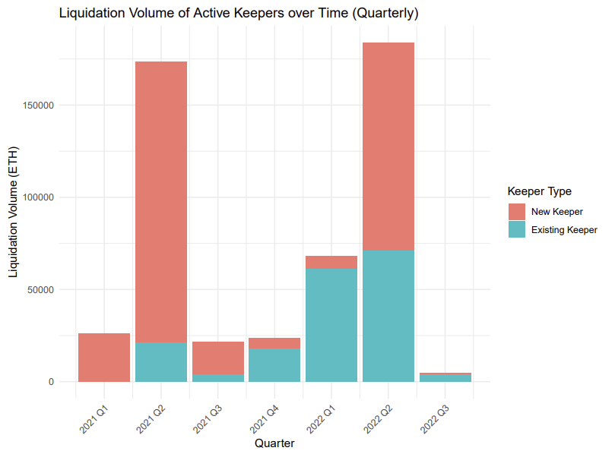
Active Keepers - Liquidation Volume
Liquidation volume of new keepers spikes during market events, but quickly died out next quarter
Lack of interest after major market event?
Hard to remain competitive?

Slide 19
User Clustering

Slide 20
Clustering Basics
Find groups from unlabeled data
Based on similarity
Find patterns from data, then apply them to clusters
E.g., if x->A, x,y are similar, then y->A
Goal
Large individual differences between clusters
Small differences between individuals of the same cluster
E.g., if x->A, y->A, z->B, then x ≈ y, x ≉ z, y ≉ z
Problem: based on similarity only, no prior knowledge applied

Slide 21
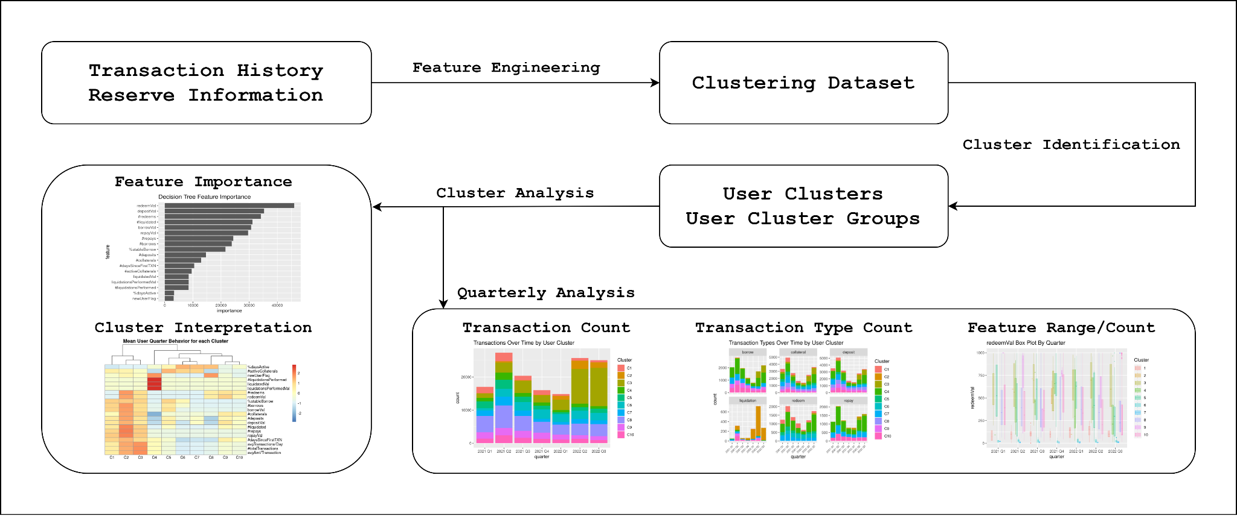
Overview
Why do we need to find user clusters?
How to find user clusters?
How to interpret user clusters?
How to use user clusters in data analytics?

Slide 22
Feature Engineering
Transaction Summary
Quarterly count and amount for each transaction type
In Quarter Summary
Specific user behavior within a quarter
E.g. Stable Borrow Proportion, Average Transactions Per Day
Historical Features
Comparison between current quarter and previous quarters
E.g. New User Flag

Slide 23
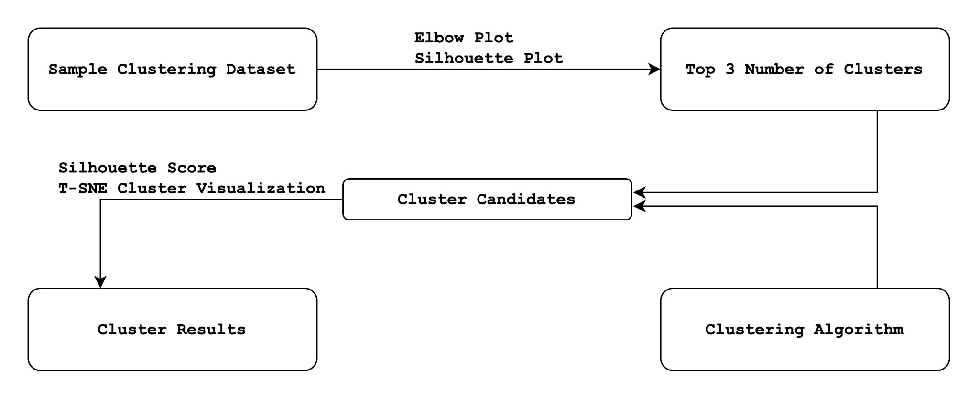
Cluster Method Overview

Slide 24
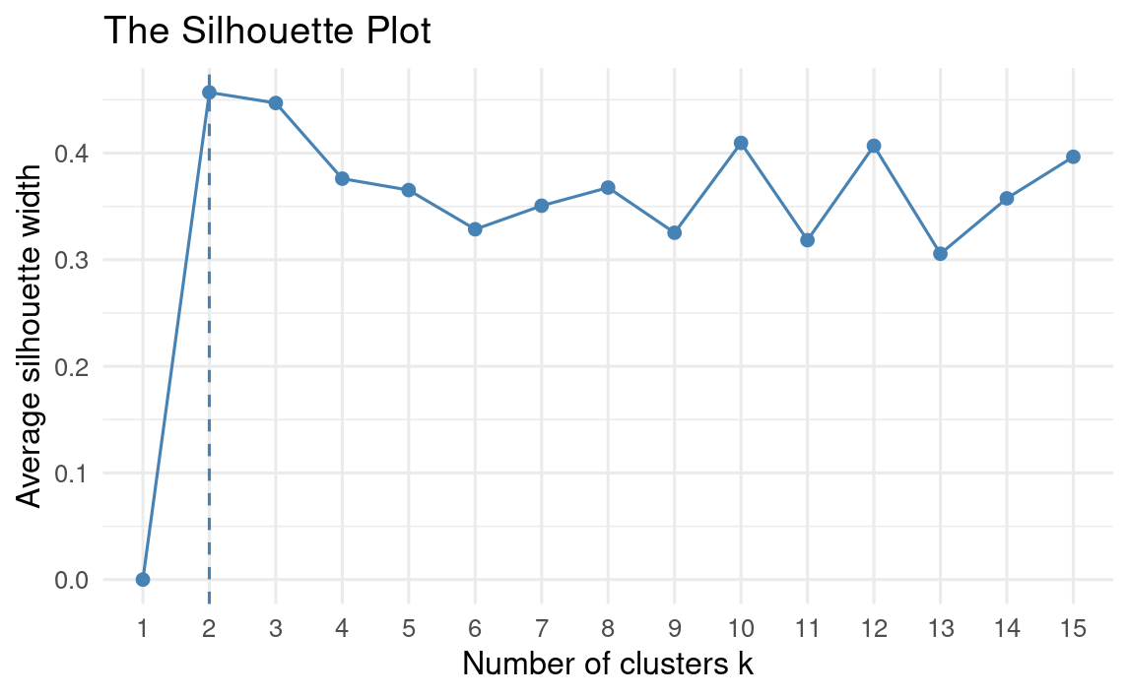
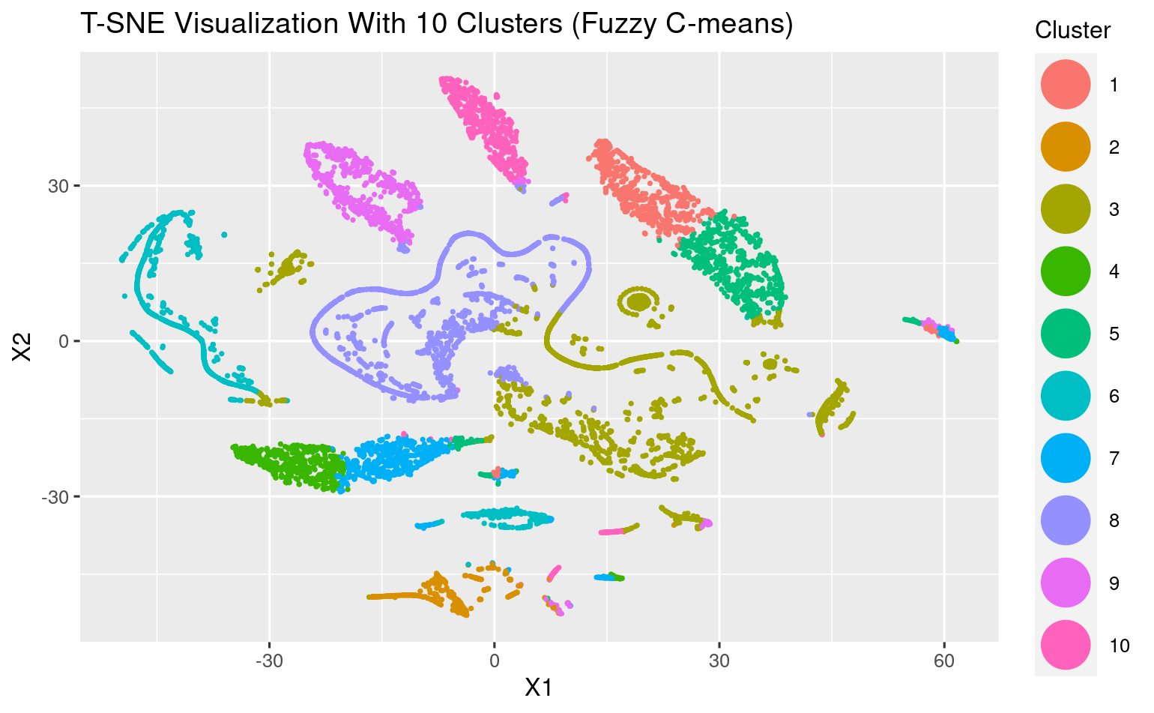
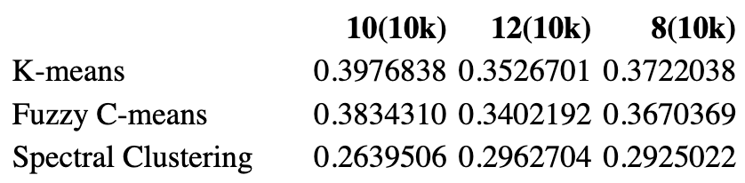
Cluster Evaluation
Which method is the best to find the clusters?
Number of clusters: find peaks in the silhouette plot
Clustering algorithm: k-means, fuzzy c-means, spectral clustering
Evaluated by Silhouette Score and T-SNE visualization
A measure for intra & inter cluster distance

Slide 25
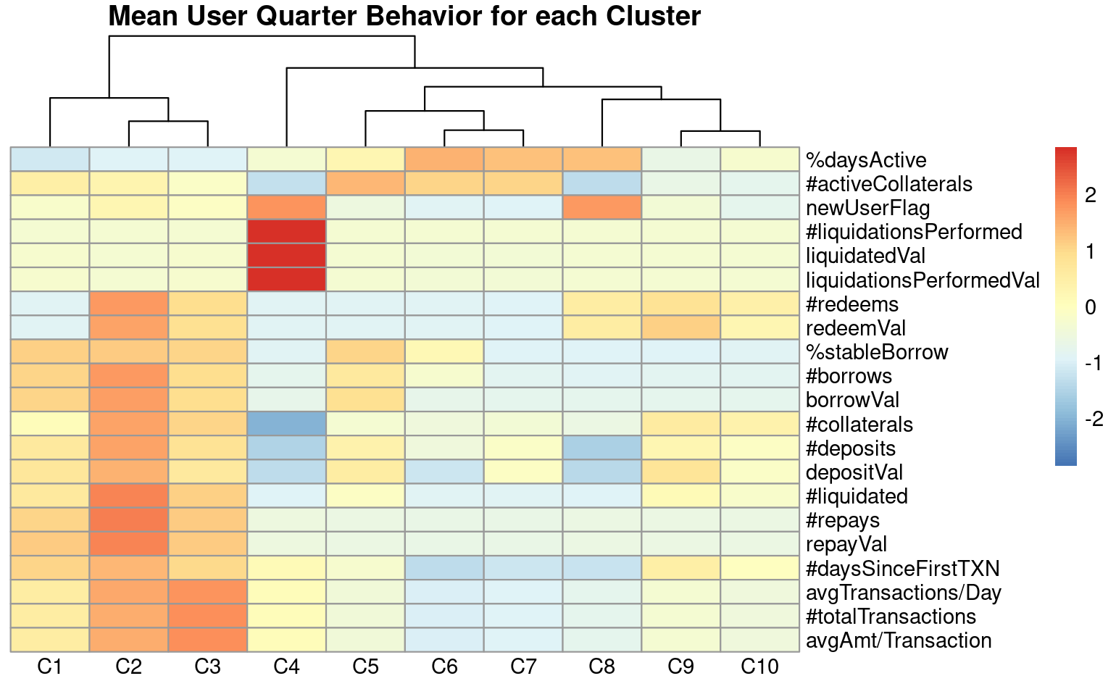
User Cluster Interpretation
Find difference between each cluster
Professionals (C1, C2, C3)
High transaction number and amount
Newcomers (C4)
Risky new users who get liquidated
Regulars (C5, C6, C7)
Active users with low transactions
Beginners (C8)
New users who rarely get liquidated
Amateurs (C9, C10)
Existing users with average transactions

Slide 26
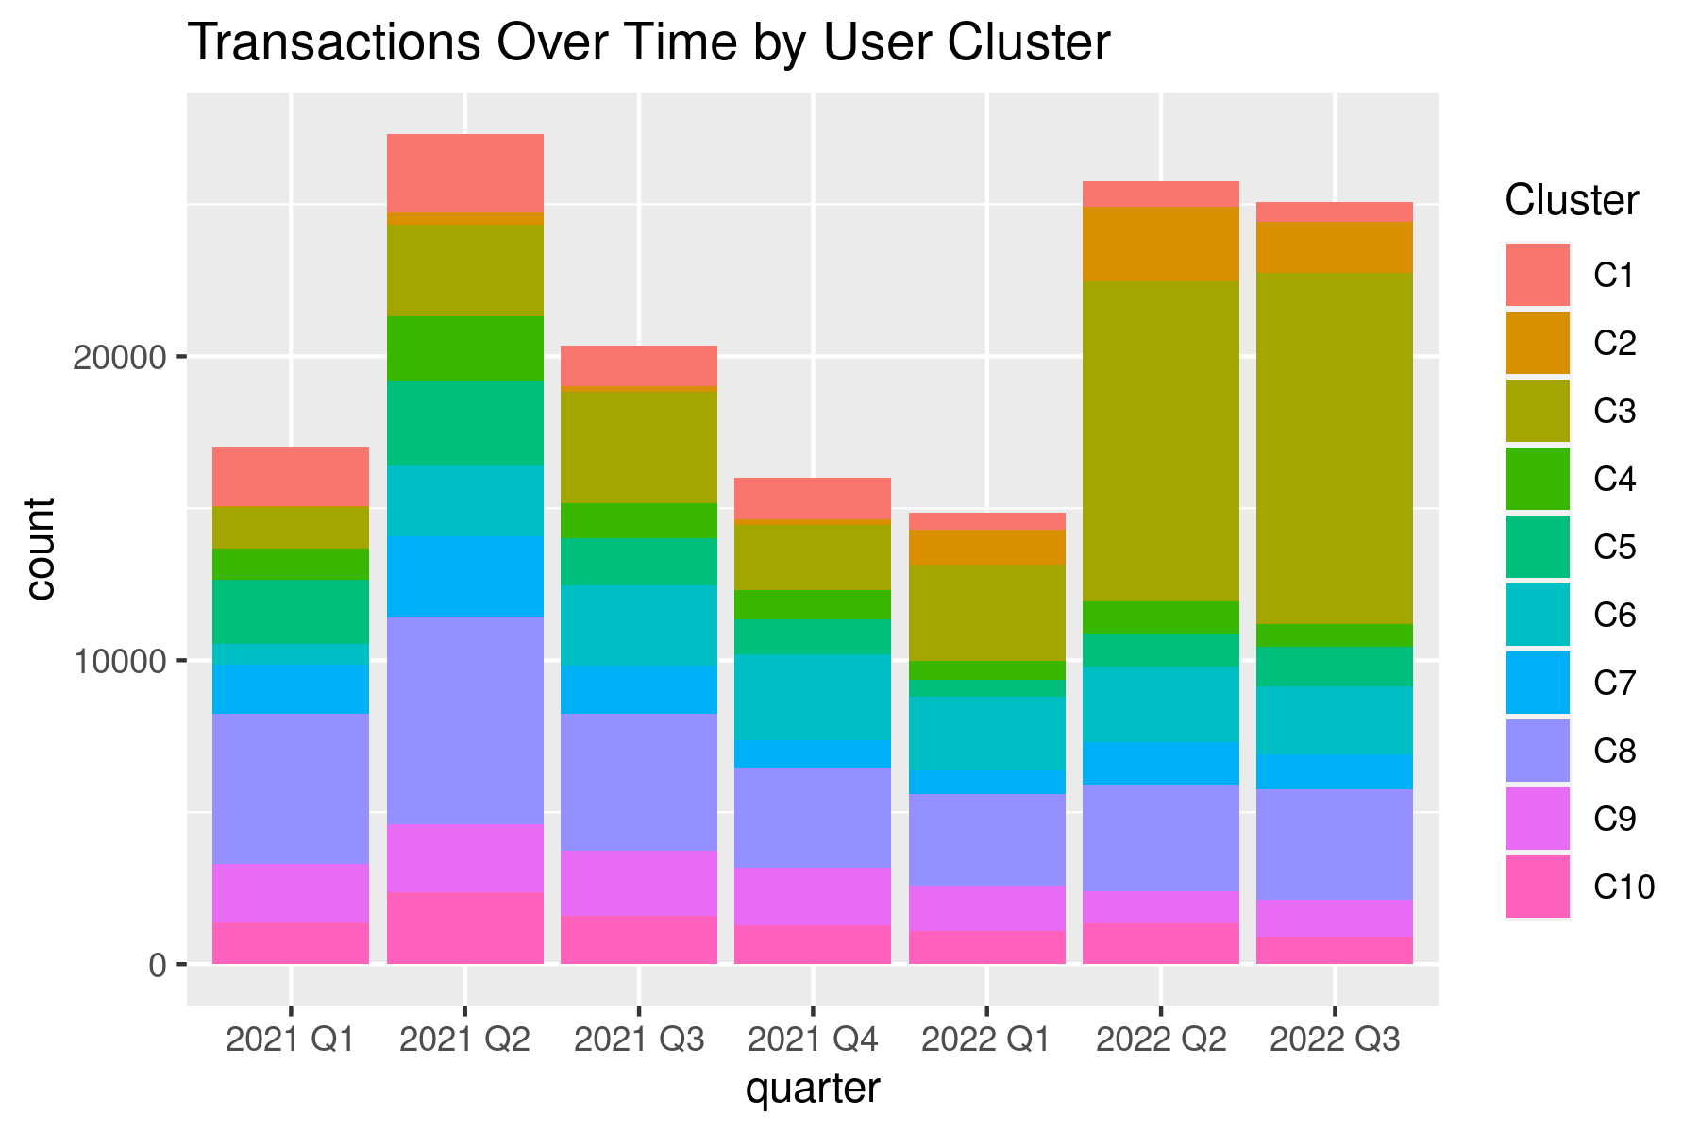
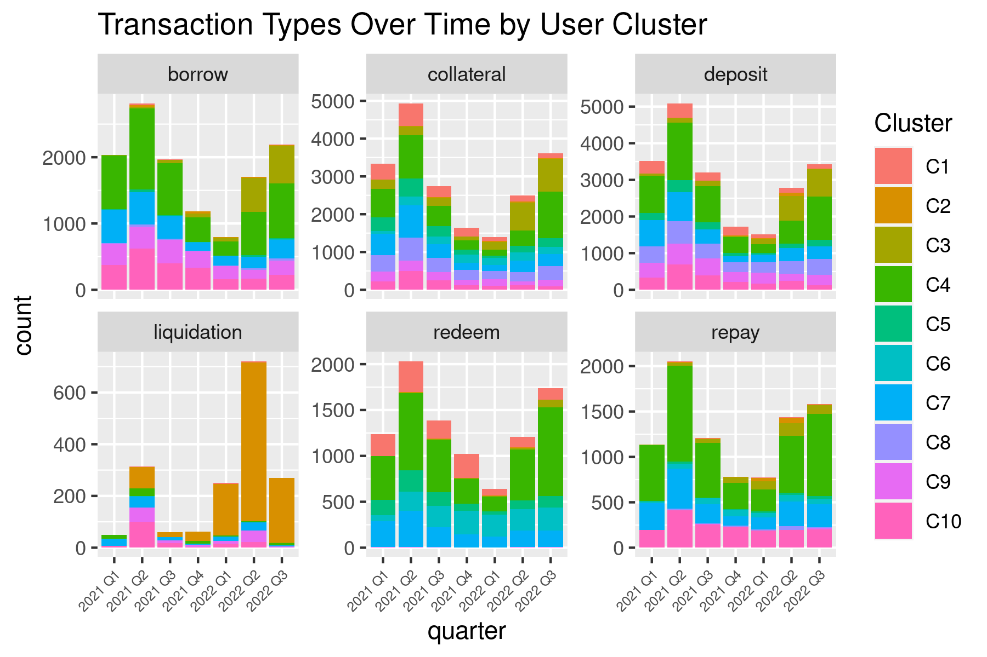
User Cluster Quarterly Analysis
Without clusters: overall market trend (a sudden increase in 2022 Q2)
With clusters:
C3 (Professionals) contributed the most to this sudden increase (collateral and borrow)
C2 (Professionals) contributed the most to the liquidation

Slide 27
Conclusions
Key Findings
Feature engineering helps find user clusters
Transaction type features
In-quarter features
Historical features
No clustering method is perfect
Compare different clustering algorithms with different numbers of clusters
Evaluate with silhouette score and T-SNE visualization
User clusters are important in the quarterly analysis
More details on user behavior
More potential reasons for changes
Future Outlook
Include more historical features
Analyze other market data

Slide 28
Survival Analysis

Slide 29
Survival Analysis Methods
Kaplan-Meier curve and hazard function
borrow to repay by quarter
-by market trend
-by loan amount
borrow to liquidation by quarter
-by collateral and reserve type
borrow to next transaction type

Slide 30
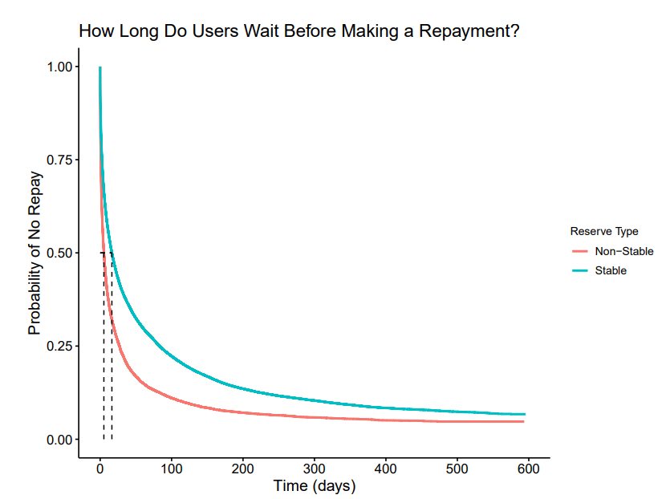
Kaplan-Meier Survival Curve
The Kaplan-Meier curve shows the probability that a subject will survive up to a specific time.
The curve is constructed by plotting the survival function against time.
The x-axis represents the time, and y-axis represents the probability of survival.

Slide 31
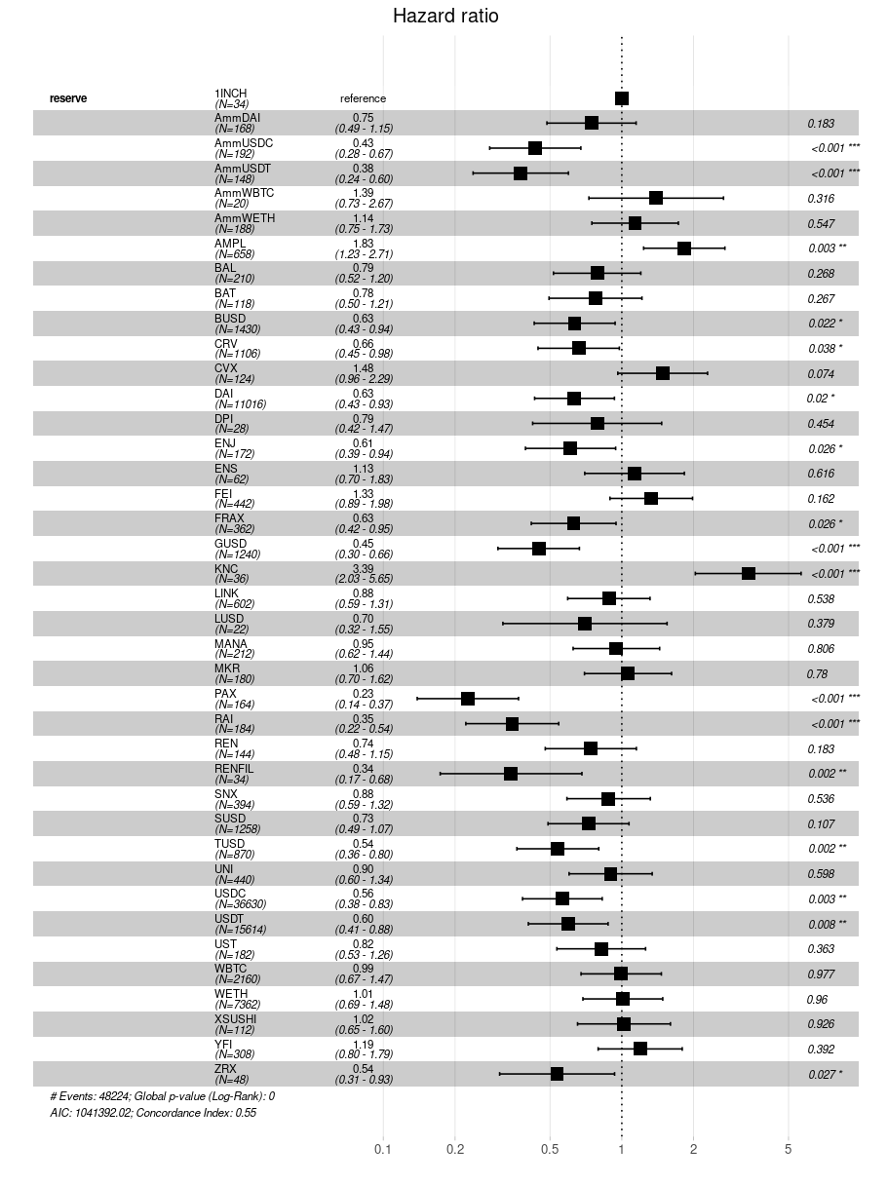
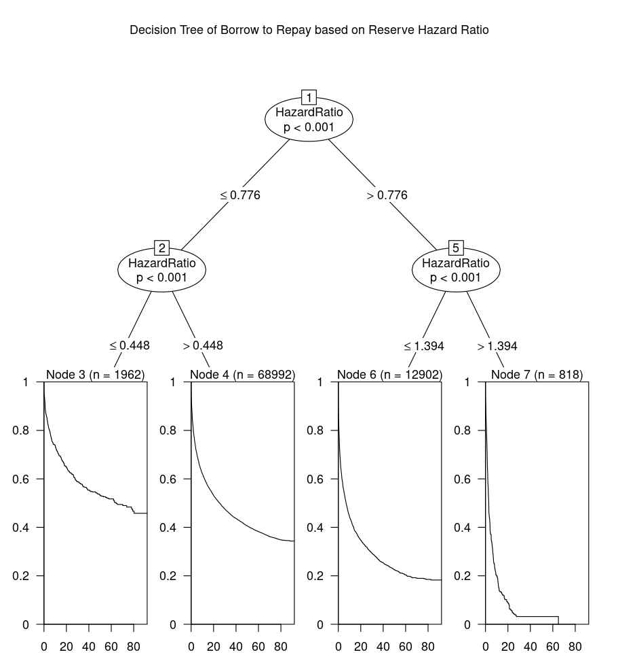
Hazard Ratio and Kaplan-Meier Survival Curve
Hazard ratio for stable coins are less than 1.
Higher hazard ratio causes higher and sooner repayment rate.

Slide 32
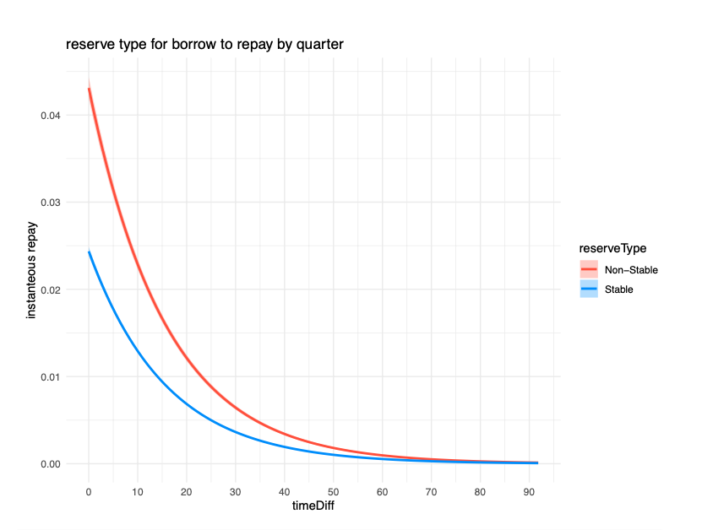
Hazard Function
The hazard rate :
-general cases: measures the propensity of an item to fail or die depending on the age it has reached.
-DeFi:show the instantaneous rate in the same time of each event
model of hazard function for spline of time difference and reserve type

Slide 33
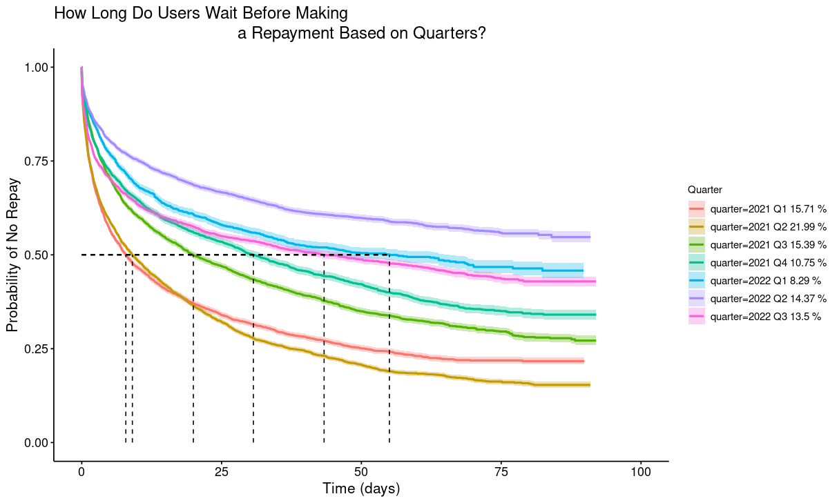
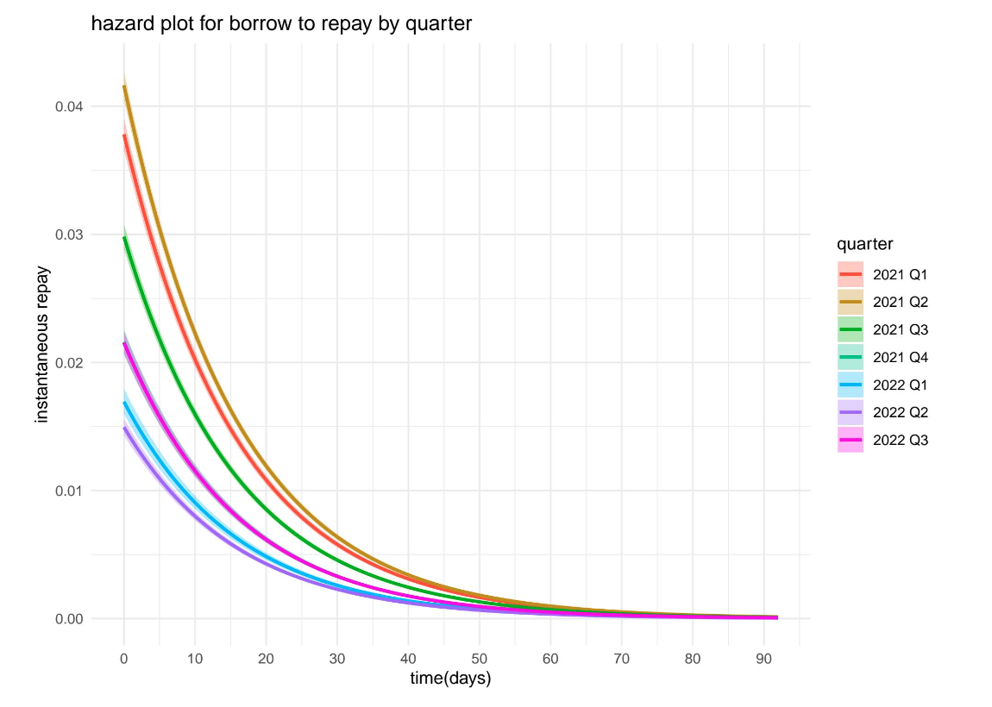
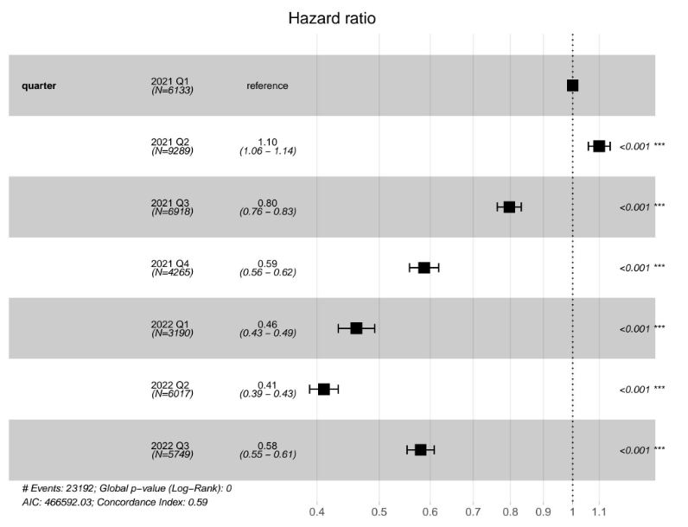
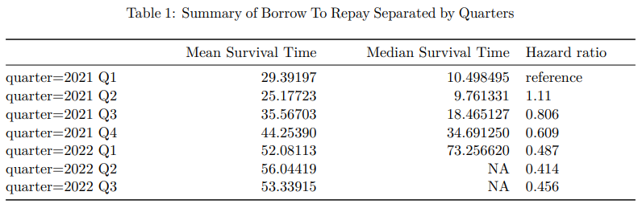
Borrow to Repay Separated by Quarters

Slide 34
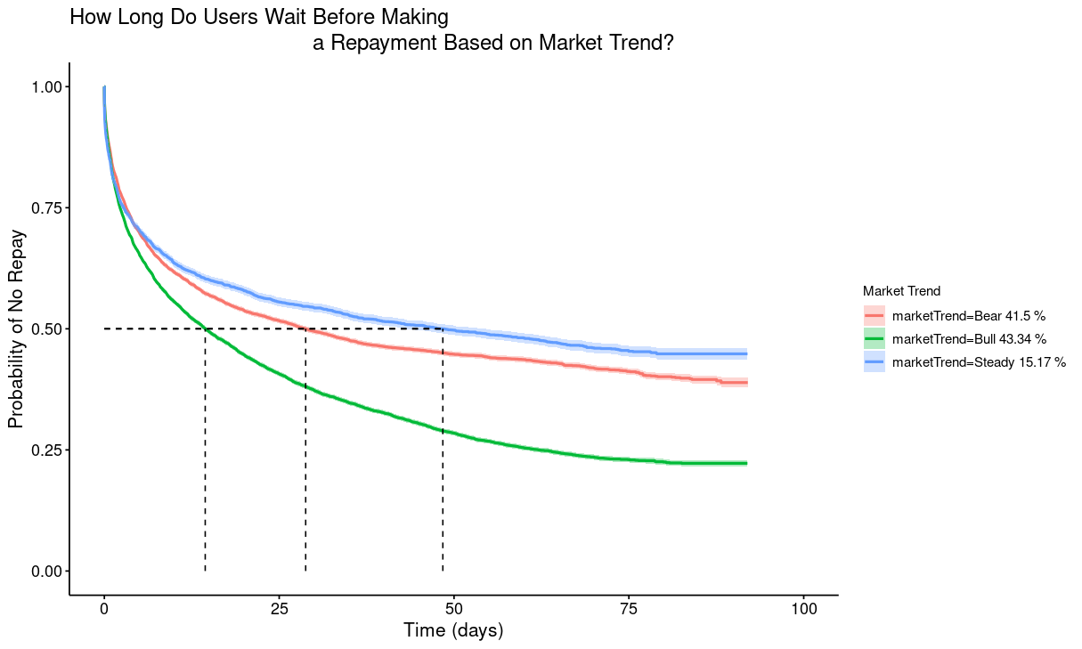
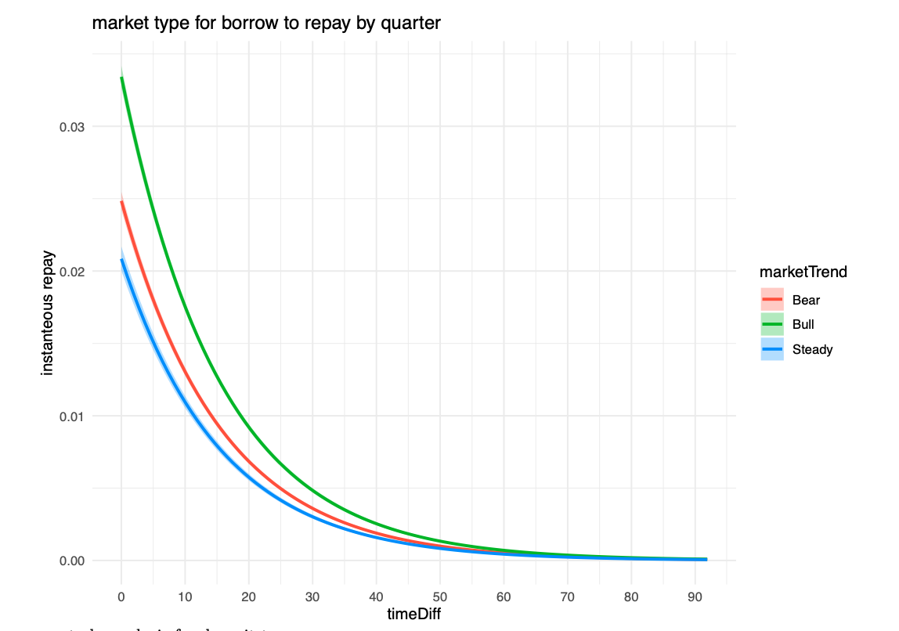
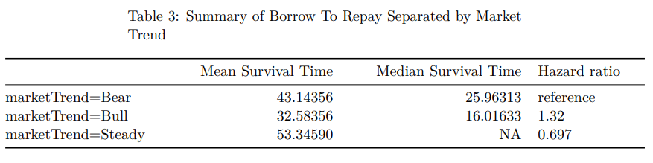
Borrow to Repay Separated by Market Trends

Slide 35
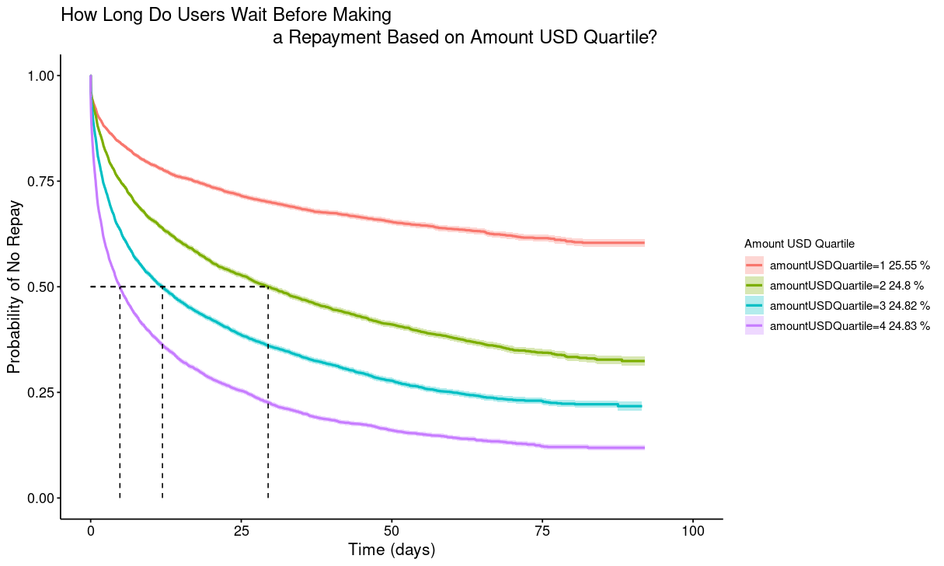
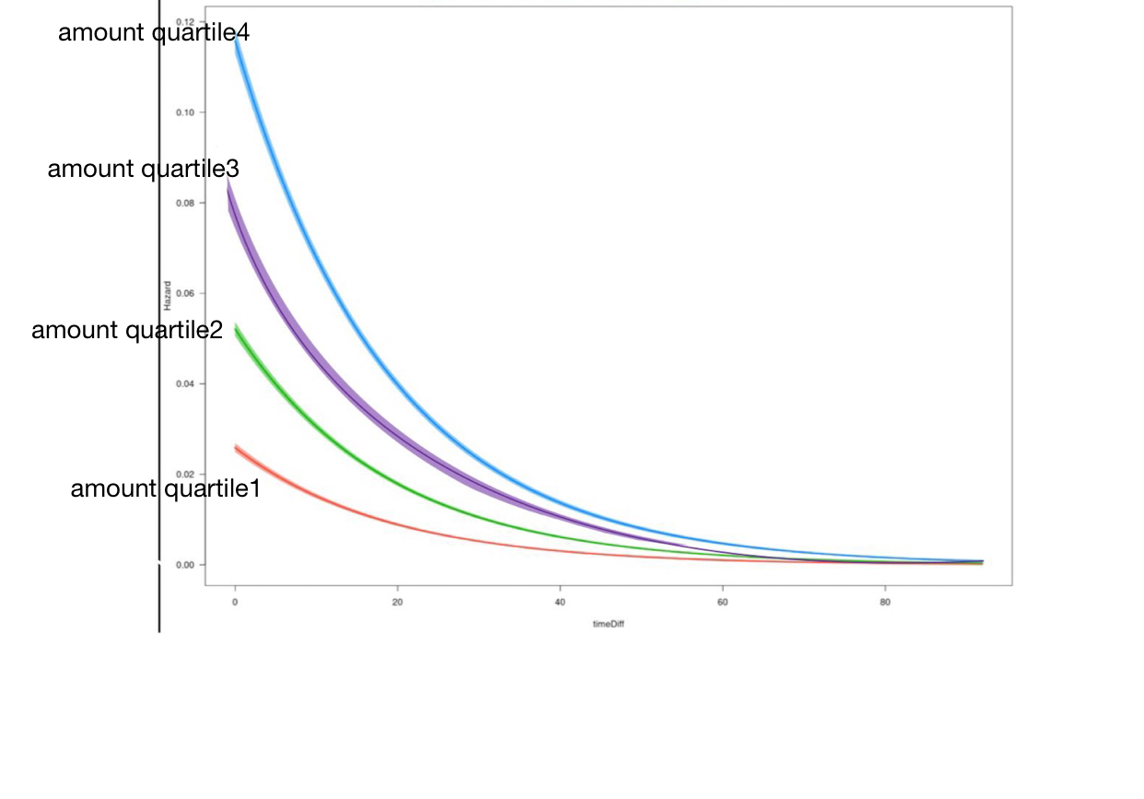
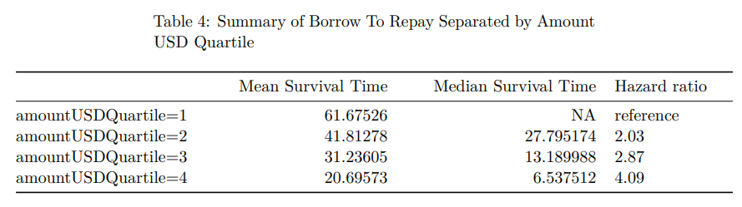
Borrow to Repay Separated by the Loan Amount

Slide 36
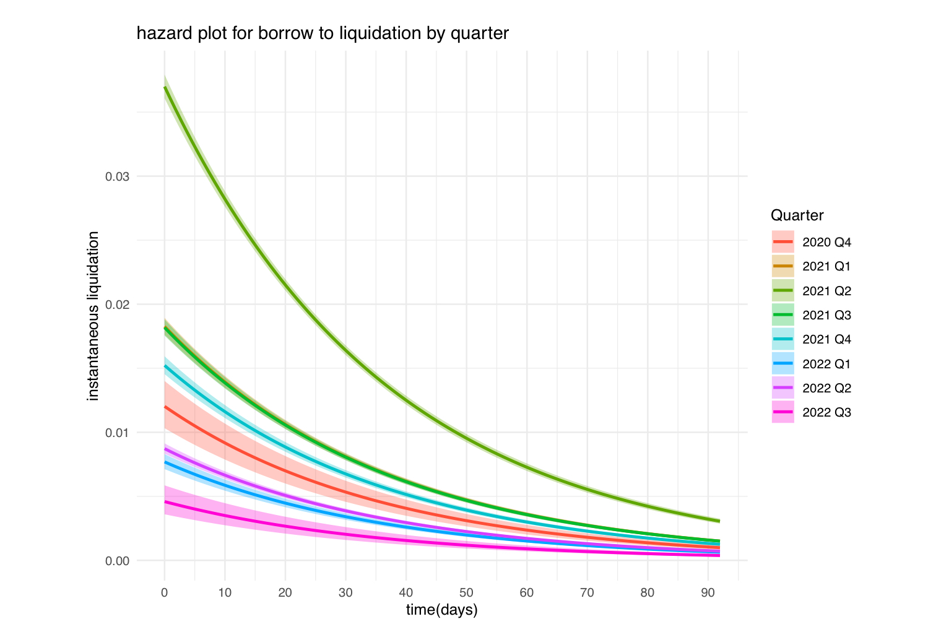
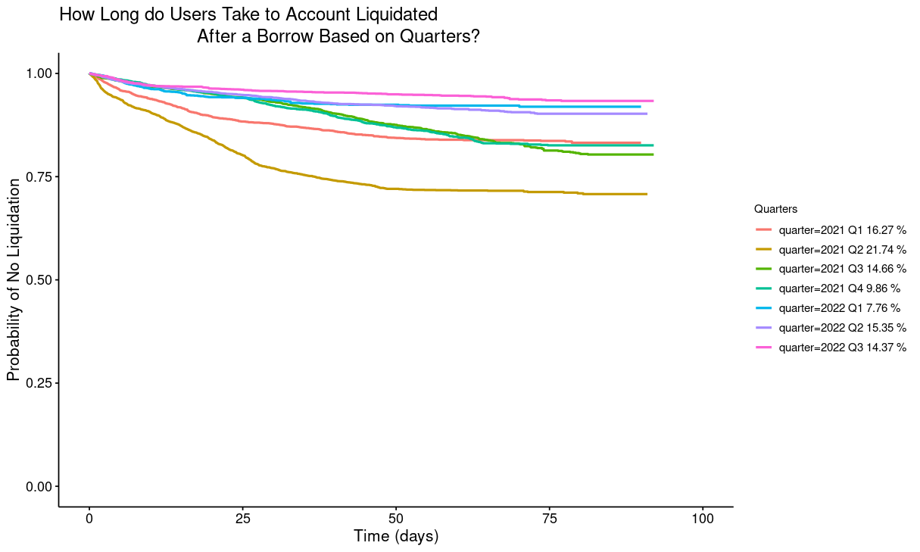
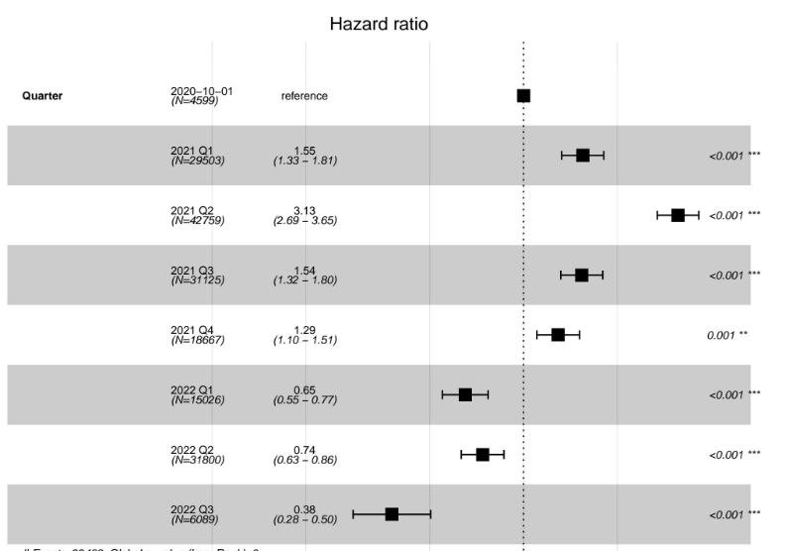
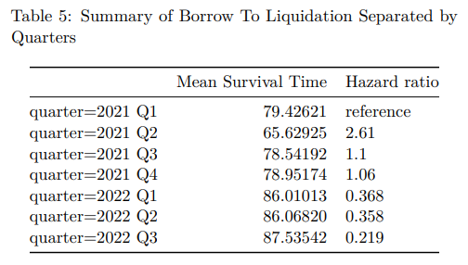
Borrow to Liquidation Separated by Quarters

Slide 37
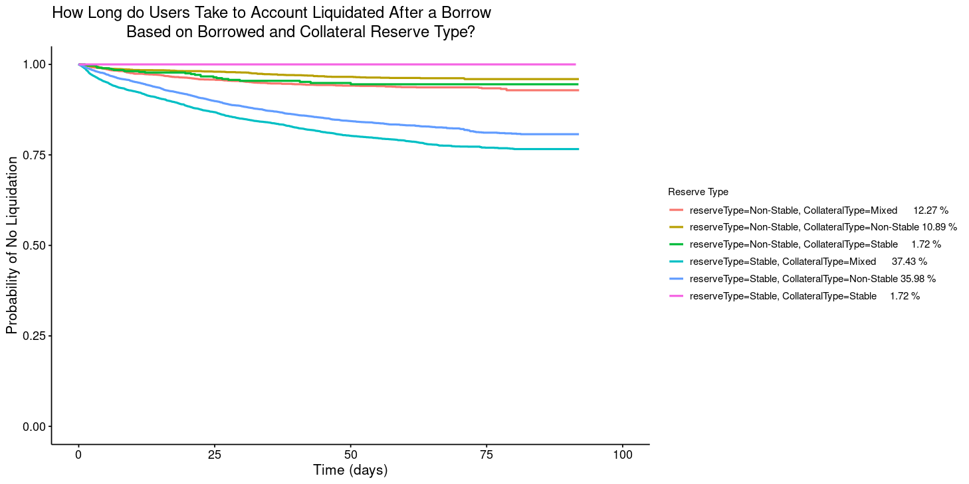
Borrow to Liquidation Separated by Collateral and Borrowed Reserve Type
Most of users borrow the stable coins and set up their collateral using the mix of stable and non-stable coins.
However, the probability of no liquidation in the stable reserves is less than others.

Slide 38
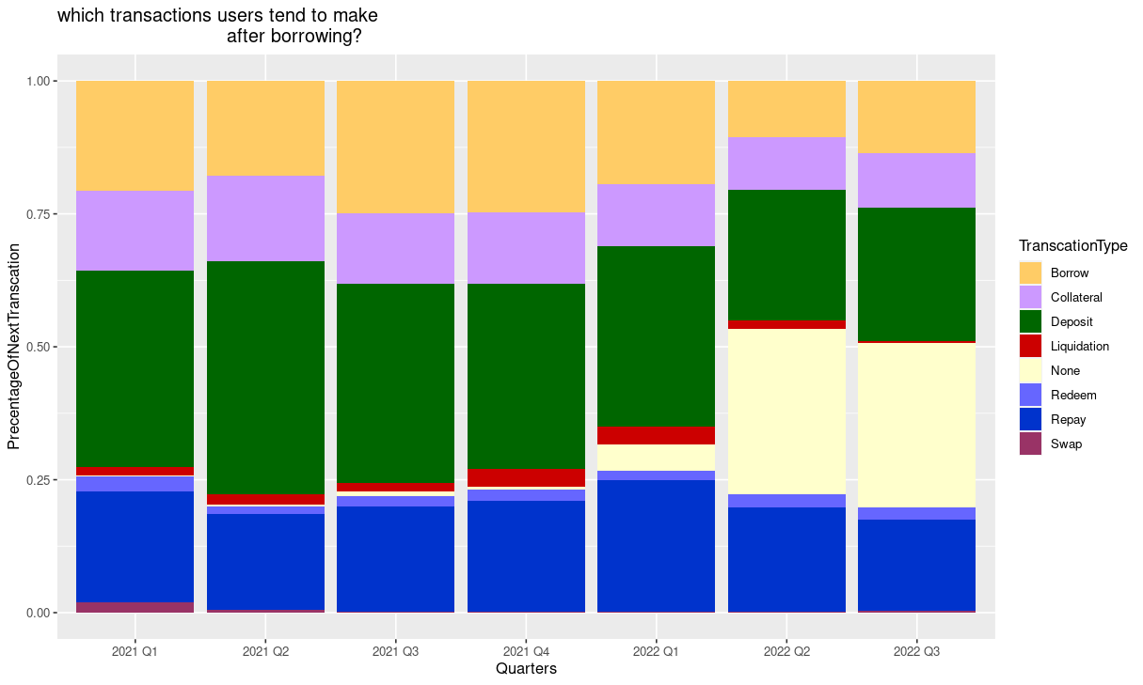
Borrow to Next Transaction Type
The most popular transaction after Borrow is Deposit. The second is Repay.
The Borrow event shows a decreasing trend in 2022. Especially in 2022 Q2, more users don’t make any further actions after Borrow.

Slide 39
Data Engine

Slide 40

Data in the DeFi Universe
Blockchain
Data Feed Providers
Researchers

Slide 41





General Overview
Purpose:
Quick and easy data flows
Language agnostic connections
Robust and stable backend
Supports and data source and standardizes output
Save time through local data storage
Current Features:
Integrated External Source Data Calls (Amber Data)
Historical Database Management
Stream Key Management
Automatic Data Request Handling
Multi-User Handling
Fully Dockerized
Continuous Deployment via Github Actions

Slide 42
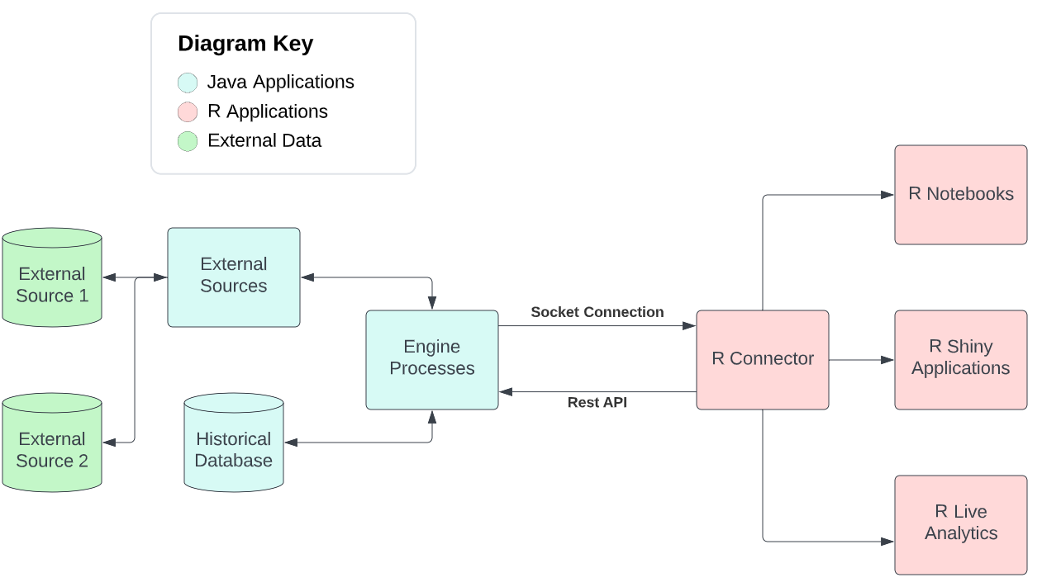
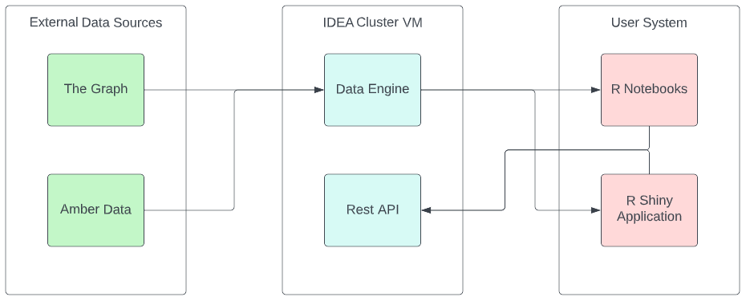
General Application Overview
Two Primary Applications:
Main Engine Framework
REST API Application
Designed in Java SE17
Utilizes Spring and Maven for compilation
Uses MongoDB for internal storage

Slide 43
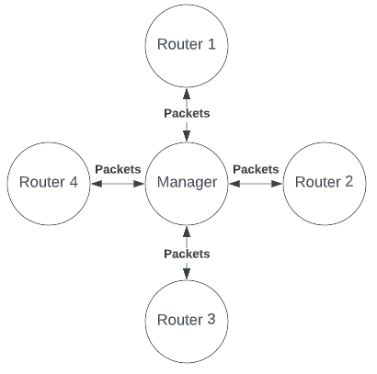
Architecture: Low Level
Designed off of a Internet Network. Using Packets and Routers for communication between processes.
Packets:
Used for standardized communication throughout the engine
Always have a Response after being sent
Packet Contents:
sender: String
tag: String
sub_tag: String
data: HashMap<String, String>
Response:
code: int
message: String
data: String

Slide 44
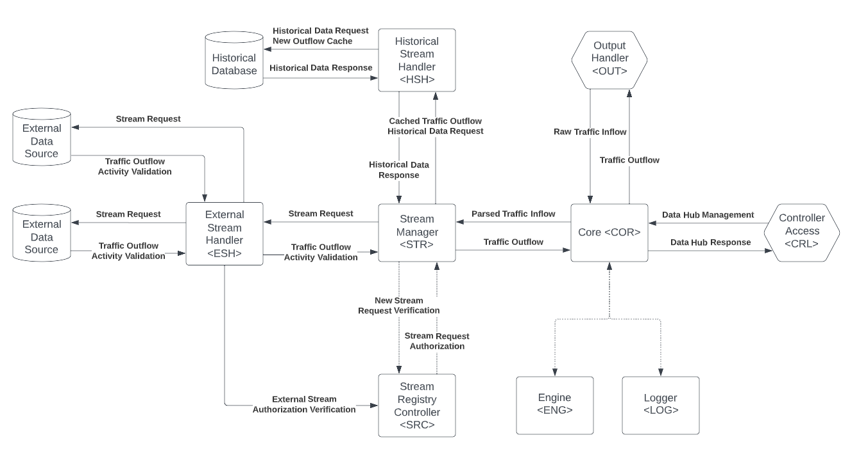
Architecture: High Level

Slide 45
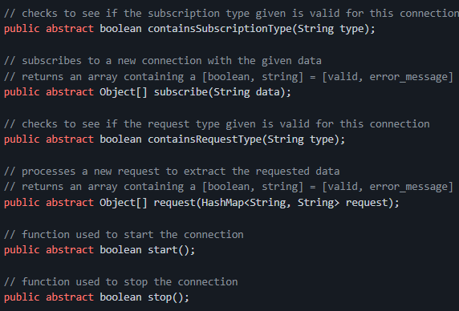
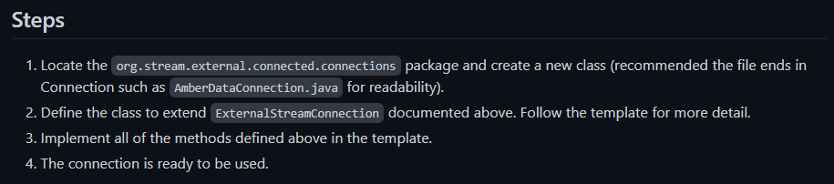
Data Stream Configuration
Easy to add new streams
Offers a lot of versatility to developers
Simple process
Standardized integration within the engine
Documentation can be found here

Slide 46
General Maintenance and Future Steps
General Maintenance:
Making sure there are no edge cases that cause issues (creating a rigorous testing suite)
Github Actions will prove useful here to unit test Docker containers and protect our repo’s main branch
Future Steps:
Server-side parsing
Streamlining the socket protocol and user interactions
Managing the internal database
Increasing efficiency of processes
Improving Java Documentation
Adding a GUI for easy management of the engine

Slide 47
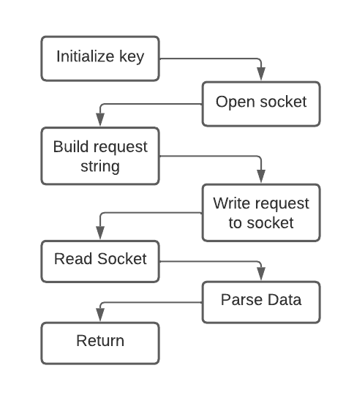
Data Retrieval and Handling in R
We provide example code for calling the engine with a basic request in R here
The function takes in two arguments: a start date (inclusive) and an end date (exclusive)
It returns a data frame containing the same schema as our current cold-storage data
As parsing is incredibly slow in R, we are looking at options for server-side parsing

Slide 48
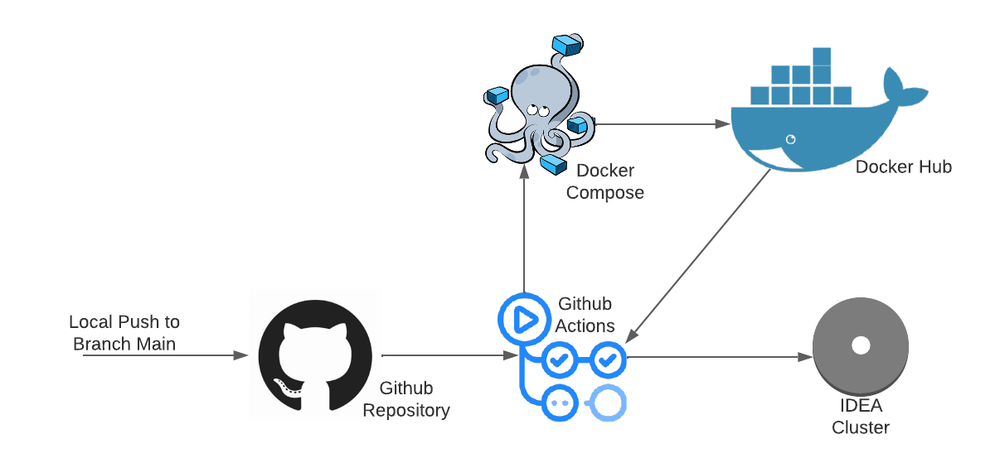
Dockerization and Continuous Deployment
We utilize Github Actions to provide continuous deployment of the engine to our IDEA cluster virtual machine.
This allows us a clean code development lifecycle and consistent uptime of the engine.
This also persists the engine and rest application as publicly available images in Docker Hub

Slide 49
The Service
The Rest API is available within the RPI network at:
http://defi-de.idea.rpi.edu:8080/defi/v1/rest
Engine Sockets can be opened on
defi-de.idea.rpi.edu:61200
More documentation on the service living in the RPI IDEA cluster can be found at:
https://github.rpi.edu/DataINCITE/IDEA-DeFi-CRAFT/wiki

Slide 50
The Service (con’t)
To run the service on your own, you need:
Docker Desktop 4.12 or later
16GB RAM or more
4 core CPU or more (for user threading)
In Linux terminal (ubuntu/redhat/centos):
$ git clone https://github.rpi.edu/DataINCITE/IDEA-DeFi-CRAFT.git
$ cd DeFi-Data-Engine
$ docker compose up
We can check listening ports via lsof
We should see listening docker processes on TCP/27017, TCP/61100, TCP/61200, TCP/8080
$ sudo lsof -i -P -n | grep LISTEN
The engine rest interface is now available at localhost:8080
Allow incoming traffic on ::8080 in local firewall if connection is refusing

Slide 51
Survival Analysis Toolkit

Slide 52
Survival Analysis Toolkit
Live app here:
https://inciteprojects.idea.rpi.edu/defitoolkit/app/defitoolkit/
Deployed on our dockerized Data INCITE Shiny proxy server
Fully equipped for multi-user simultaneous access
Capable of producing plethora of
Kaplan-Meier survival plots
Associated descriptive statistics tables
Allows comparison cross-platform/market
Values able to be extracted from toolkit
Hazard ratio forest plot
User-friendly, quick creation of these plots

Slide 53
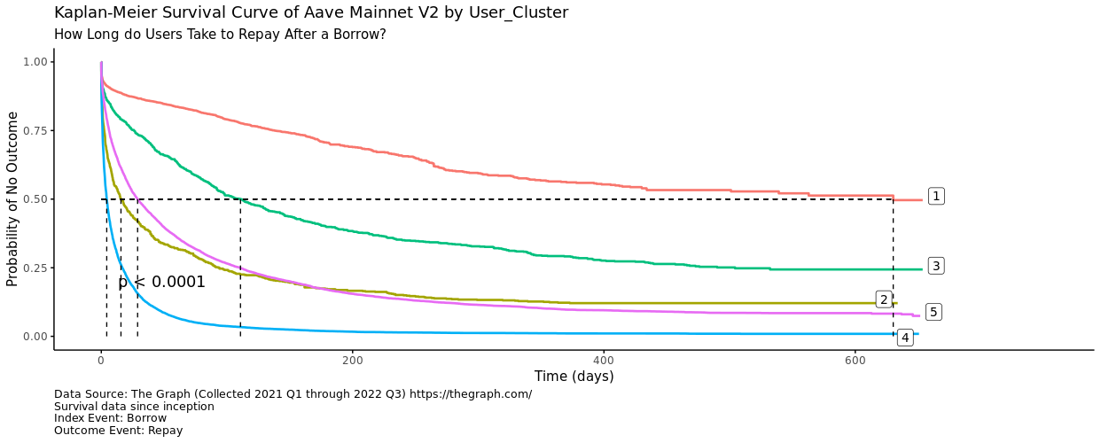
Let’s look at some plots that can be generated in seconds

Slide 54

Let’s look at some plots that can be generated in seconds

Slide 55

Let’s look at some plots that can be generated in seconds

Slide 56

Let’s look at some plots that can be generated in seconds

Slide 57

Let’s look at some plots that can be generated in seconds

Slide 58

Let’s look at some plots that can be generated in seconds

Slide 59

Let’s look at some plots that can be generated in seconds

Slide 60

Let’s look at some plots that can be generated in seconds

Slide 61

Let’s look at some plots that can be generated in seconds

Slide 62
Many more can be made… try it out!

Slide 63
Survival Analysis Toolkit GitHub
Raw code documented for interpretability in GitHub location here:
https://github.rpi.edu/DataINCITE/DeFi_App
GitHub Wiki designed to serve as:
Documentation of:
Current scope of data
Extensible data system behind app UI generation
Methods of survival data creation
Actual app code
User guide (coming soon)
Etc.
GitHub Issues used as error reporting/to-do list

Slide 64
Project Resources

Slide 65
Resources:
Project Page:
https://idea.rpi.edu/research/projects/risky-business-deep-dives-defi
Survival Analysis Toolkit: https://inciteprojects.idea.rpi.edu/defitoolkit/app/defitoolkit/
Survival Analysis Toolkit GitHub (w/ wiki):
https://github.rpi.edu/DataINCITE/DeFi_App

